Slide 1

Sprocket Central Pty Ltd
Data analytics approach
[Division Name] - [Engagement Manager], [Senior Consultant], [Junior Consultant]

Slide 2
Agenda
Introduction
Data Exploration
Model Development
Interpretation

Slide 3
Introduction
In our project, we are working with three key datasets: transaction data, customer demographic data, and customer address data. Our objective is to ensure the quality and reliability of these datasets to drive informed decision-making and optimize business processes.
In the data exploration phase, we will meticulously examine each dataset to identify anomalies, inconsistencies, and missing values that may affect the quality of our analysis. Subsequently, we will address these issues to enhance the completeness, accuracy, and consistency of the data.
Once we have ensured the quality of our datasets, we will move on to the model development phase. Here, we will leverage the high-quality data to build robust analytical models. Specifically, we will develop a dashboard that visualizes profitability metrics based on different attributes, such as customer demographics or geographic location. This dashboard will provide valuable insights into customer behavior, allowing us to tailor marketing strategies, optimize product offerings, and improve overall business performance.
By combining rigorous data exploration with advanced model development techniques, we aim to unlock the full potential of our datasets and drive actionable insights that drive business growth and success.

Slide 4
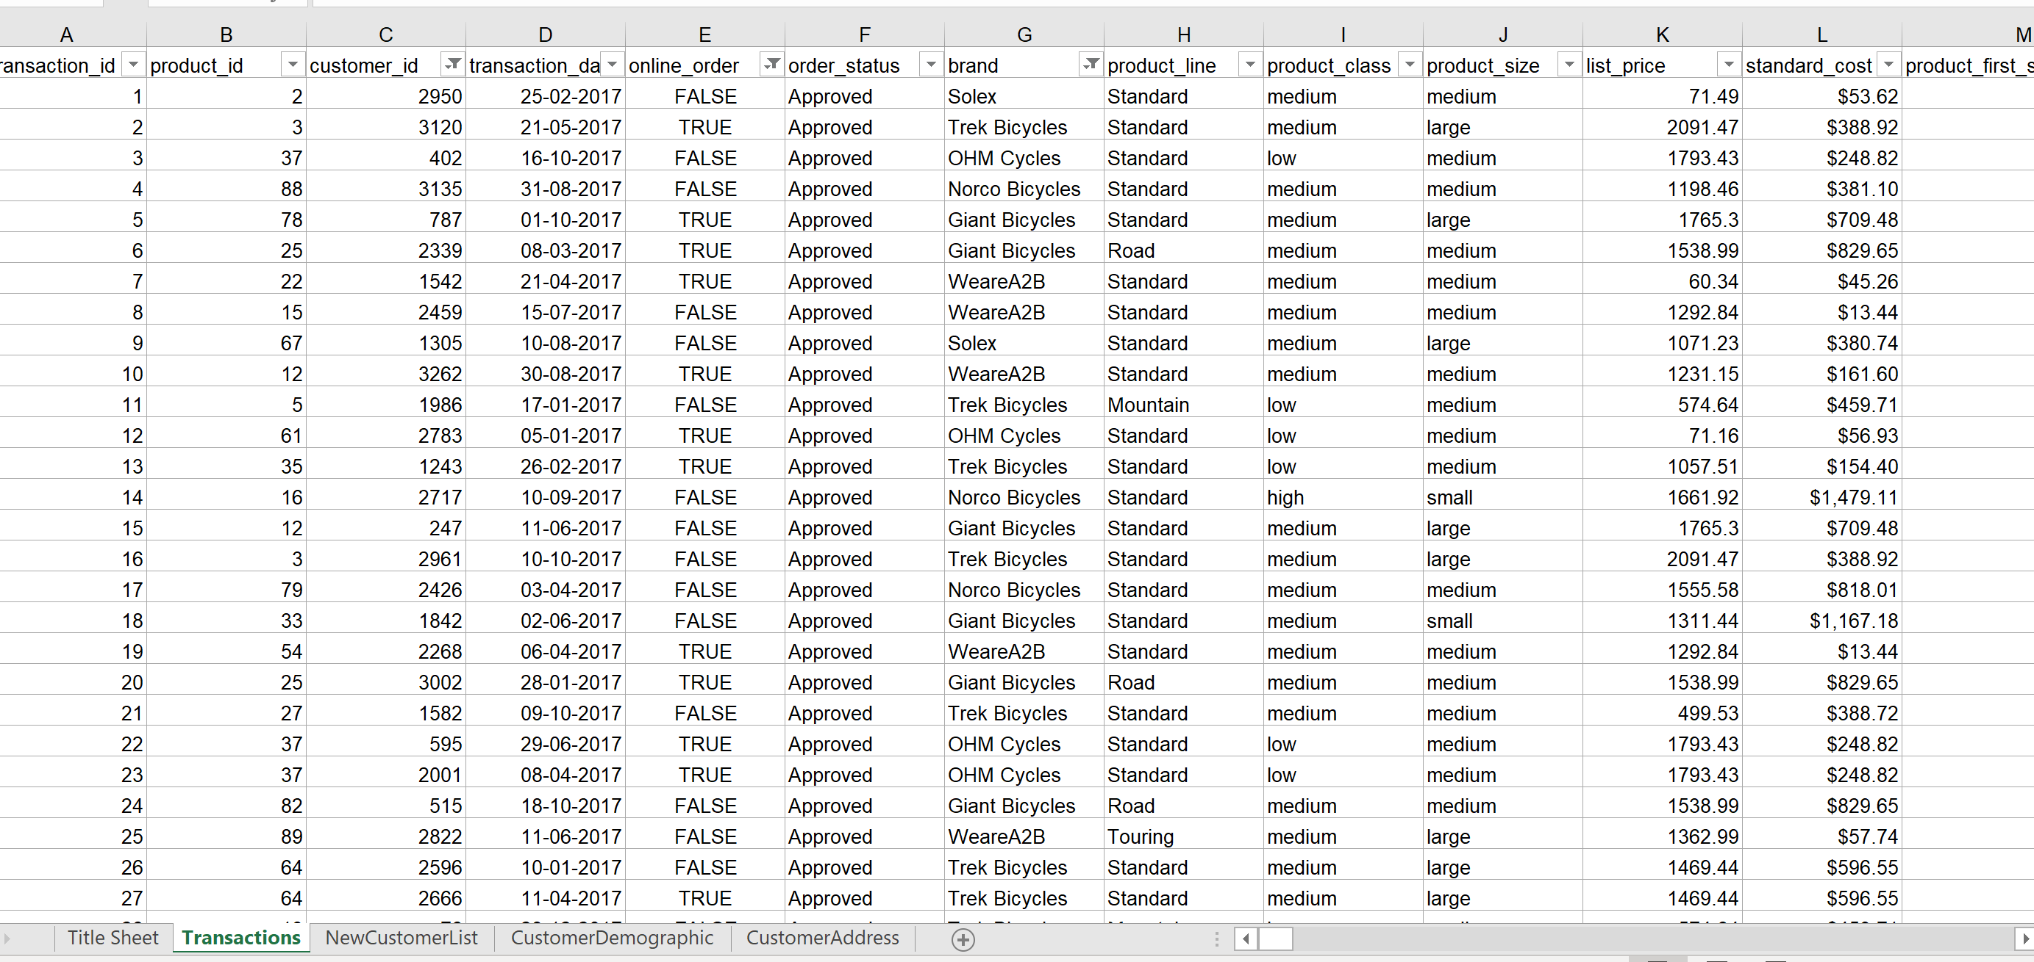
Data Exploration
In the data exploration phase, we thoroughly examined three critical aspects of our datasets: transaction data, customer demographic data, and customer address data. For transaction data, we ensured completeness, accuracy, and consistency by removing blank entries and introducing new columns for transaction date and profit. This clean transaction data is vital for understanding customer behavior and profitability. Similarly, in the customer demographic dataset, we standardized gender classifications to ensure consistency and enhance segmentation and targeting strategies. Accurate demographic data is crucial for personalized marketing efforts. Lastly, in the customer address dataset, we focused on completeness and consistency by removing blank values and standardizing state abbreviations. This ensures precise geographic targeting and optimizes logistical operations.
Place any supporting images, graphs, data or extra text here.

Slide 5
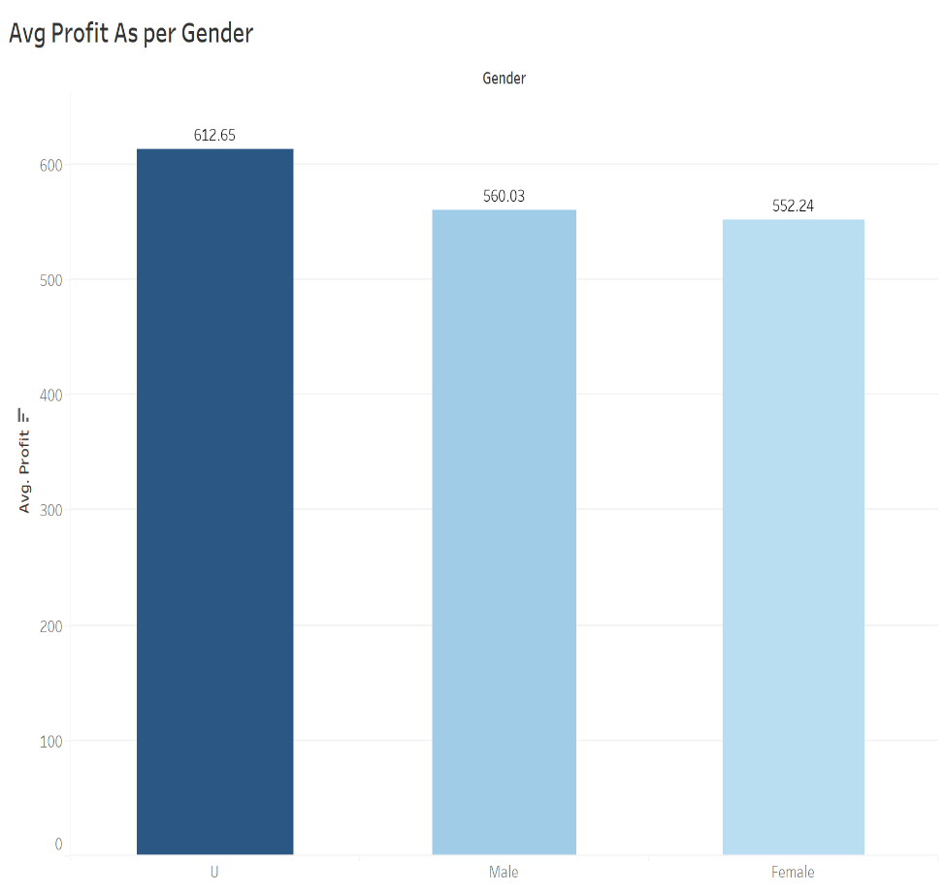
Model Development
In the model development phase, we utilized high-quality data to build robust analytical models. Leveraging clean transaction data, we conducted comprehensive analysis, including customer segmentation, lifetime value prediction, and demand forecasting, which informed strategic decision-making. With accurate demographic data, we effectively segmented customers based on various attributes, enhancing targeted marketing campaigns and improving customer engagement and retention efforts. Additionally, leveraging precise address data enabled us to conduct geospatial analysis, such as location-based targeting and market penetration analysis, maximizing operational efficiency and customer satisfaction.
Place any supporting images, graphs, data or extra text here.

Slide 6
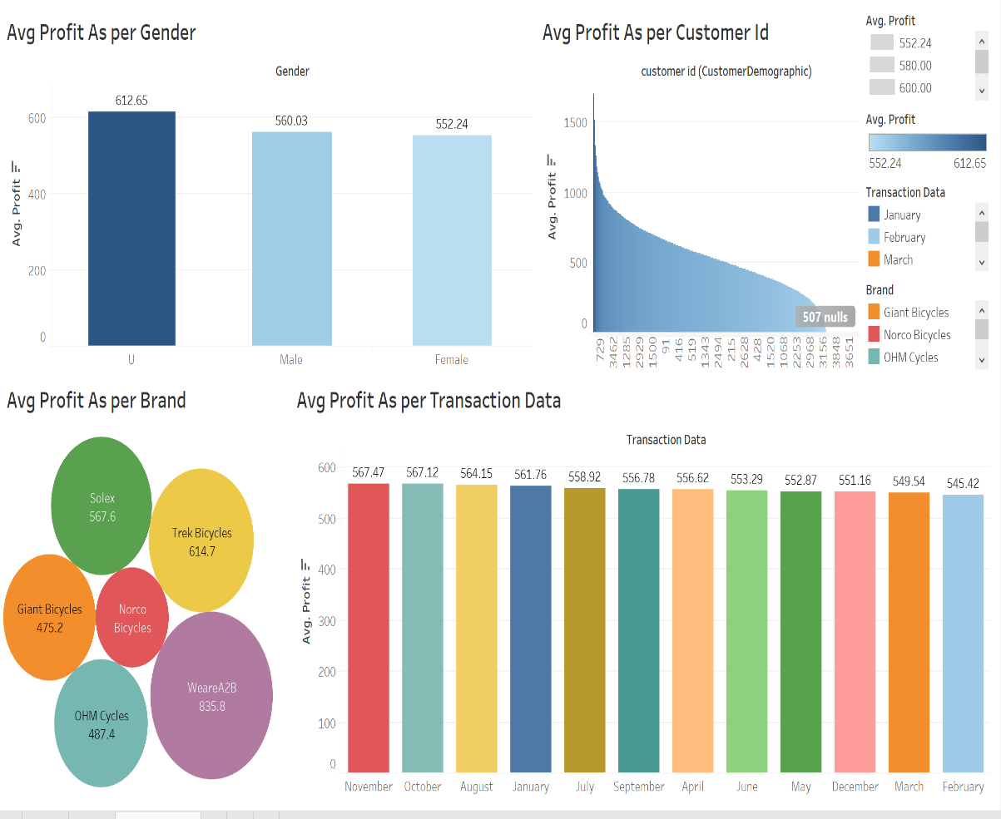
Interpretation
In the interpretation phase, we draw insights from our analysis and model development efforts to inform strategic decision-making. We'll discuss the implications of our findings and how they contribute to achieving our business objectives. Specifically, we'll emphasize:
The actionable insights derived from transaction analysis, demographic segmentation, and geospatial analysis.
The potential impact of data quality improvements on business performance metrics such as revenue growth, customer satisfaction, and operational efficiency.
The importance of ongoing data quality monitoring and maintenance to sustain the effectiveness of our analytical models and decision-making processes.
Place any supporting images, graphs, data or extra text here.

Slide 7
Thanks Regards … Umair Shaikh

